Slide 1
Evolutionary Game Theory for Multi Agent Path Planning
Sheryl Paul

Slide 2
Problem and approach
Our problem is path planning in unknown environments
Our setting is a previously unseen world with agents in a number of different start locations, trying to reach one of the goal locations
Our assumption is that they have little to no visibility, and the environment has quite a few obstacles and is difficult to navigate. (For e.g. the Mars Rover problem)
Our solution approach is using the principles of Evolutionary Game Theory to train these agents, by growing the population of policies that perform well, and thereby also increasing the likelihood of their selection.
We can also practically show that our trained policies are Evolutionary Stable Strategies- a subset of the Nash Equilibria, as they do not change upon the introduction of other policies/with additional training.

Slide 3
Applications
Fire fighting/search and rescue
Mars rover problem
Warehouse settings

Slide 4
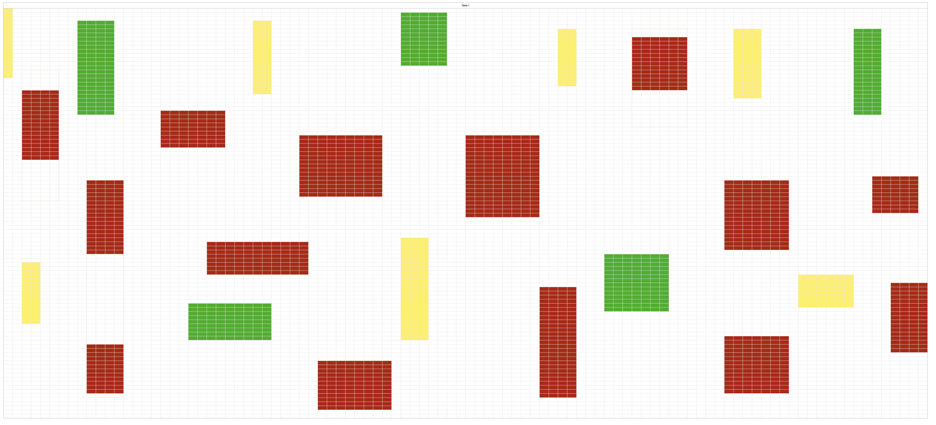
Example setting
Yellow: Start locations
Red: Obstacles
Green: Goal locations

Slide 5
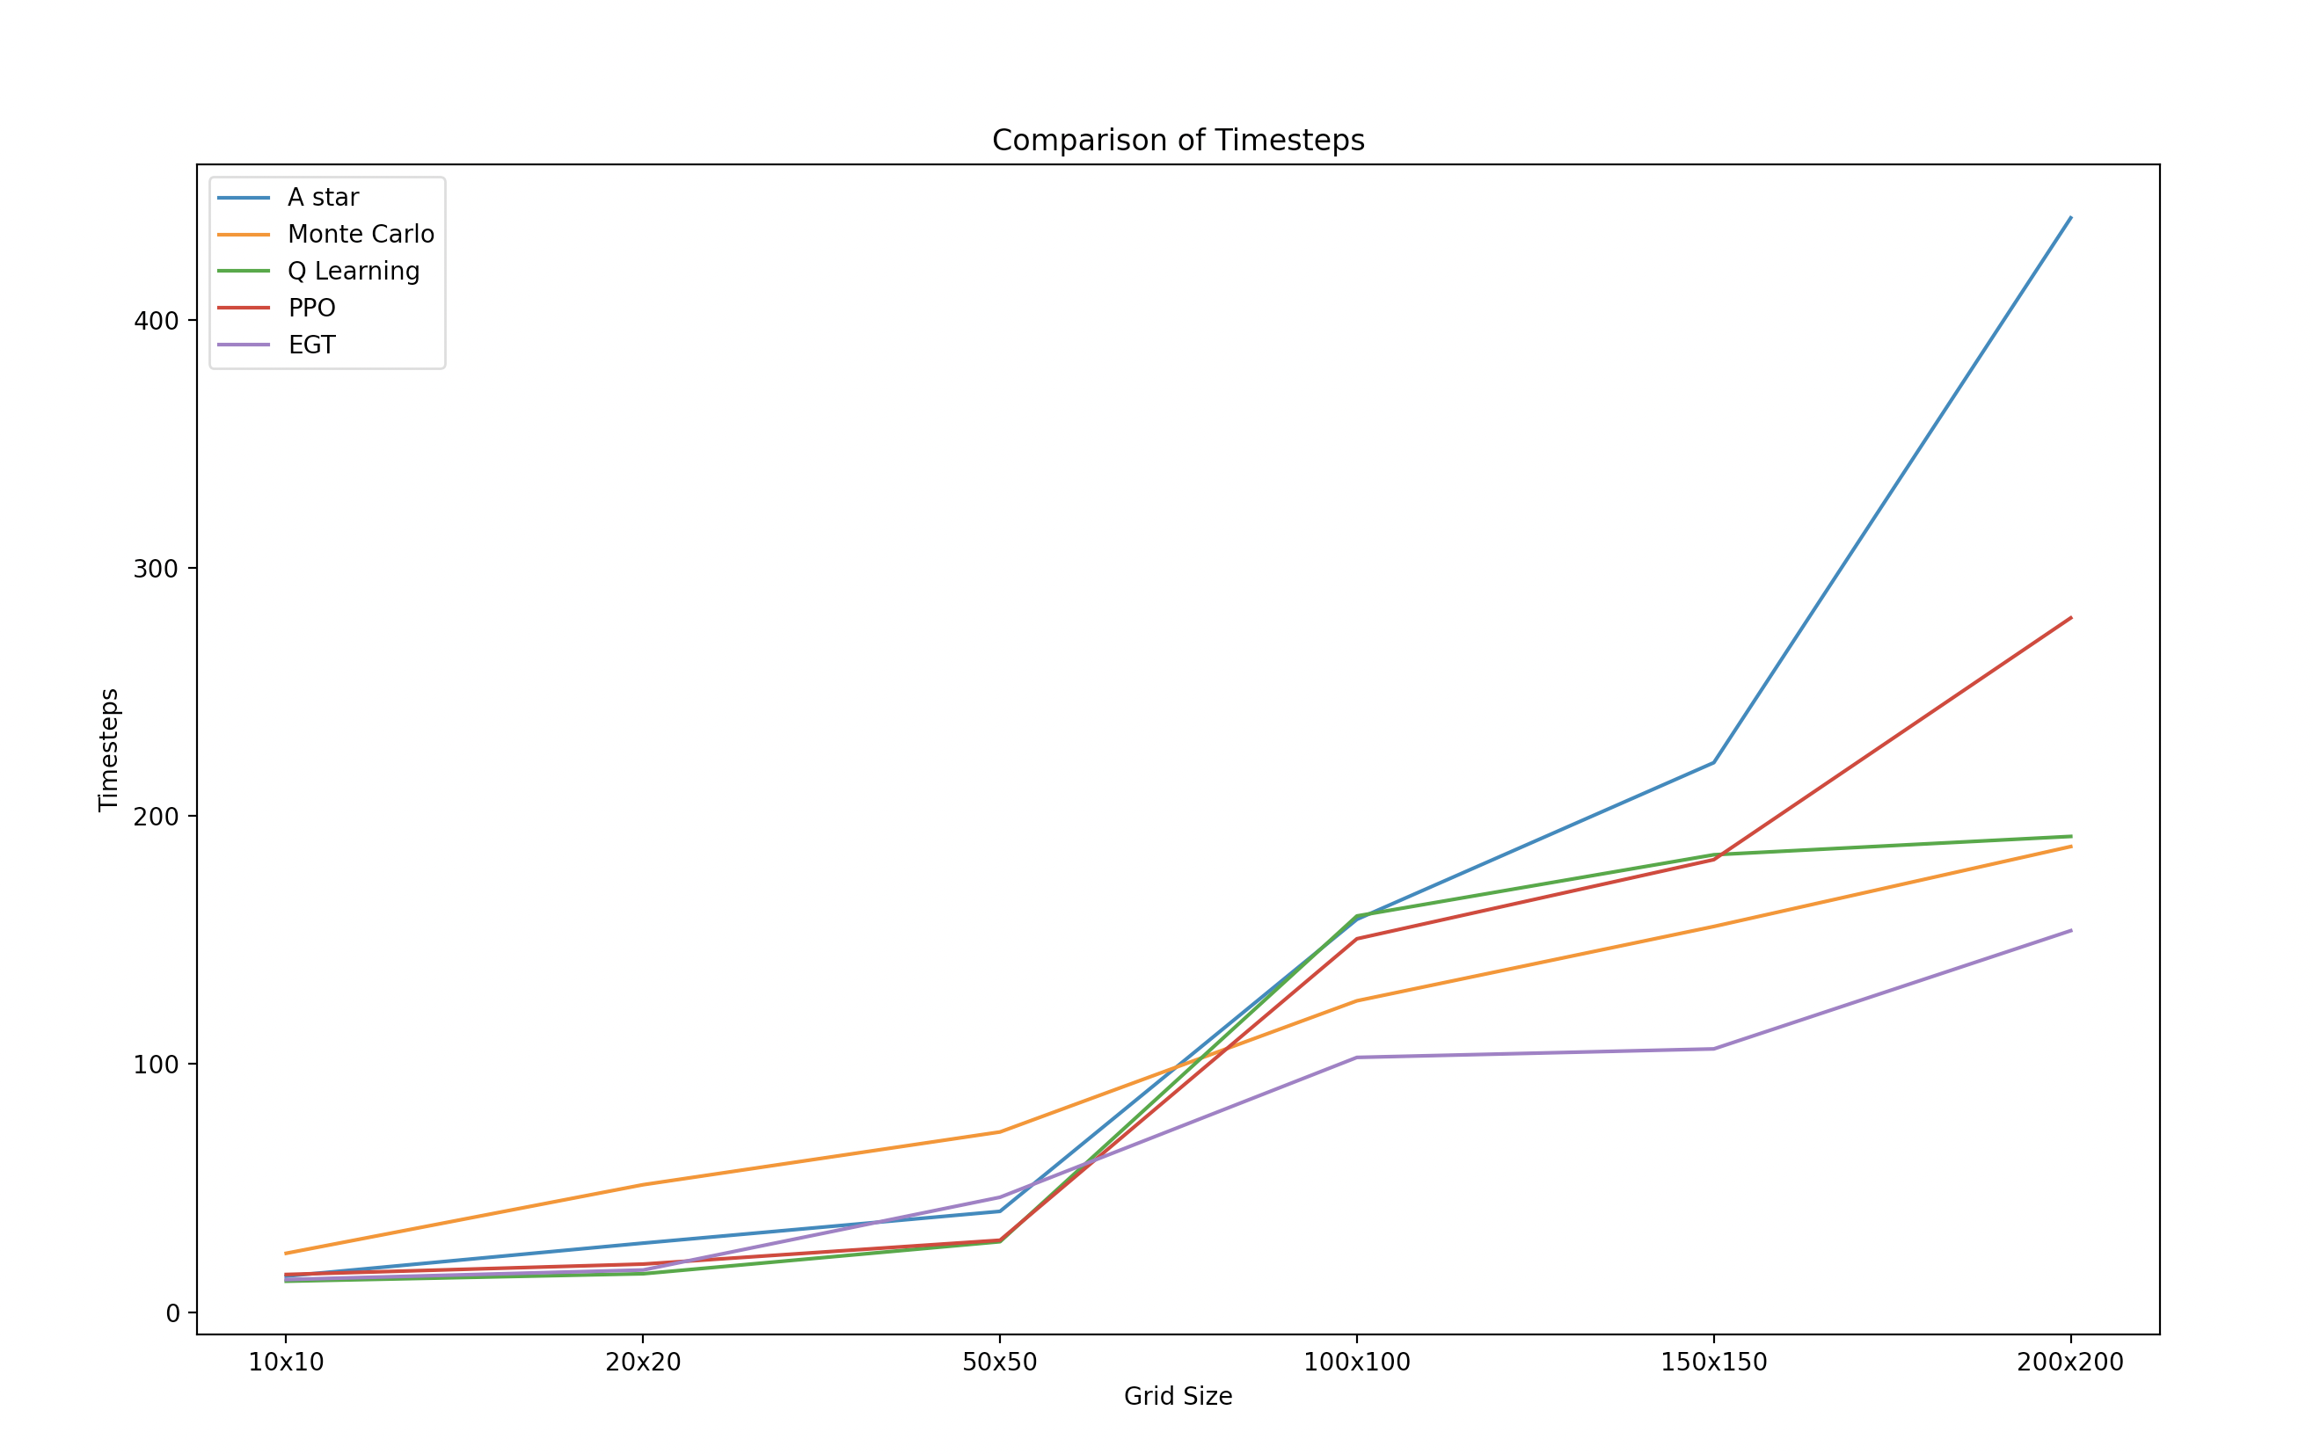
Results and Comparison to known algorithms

Slide 6
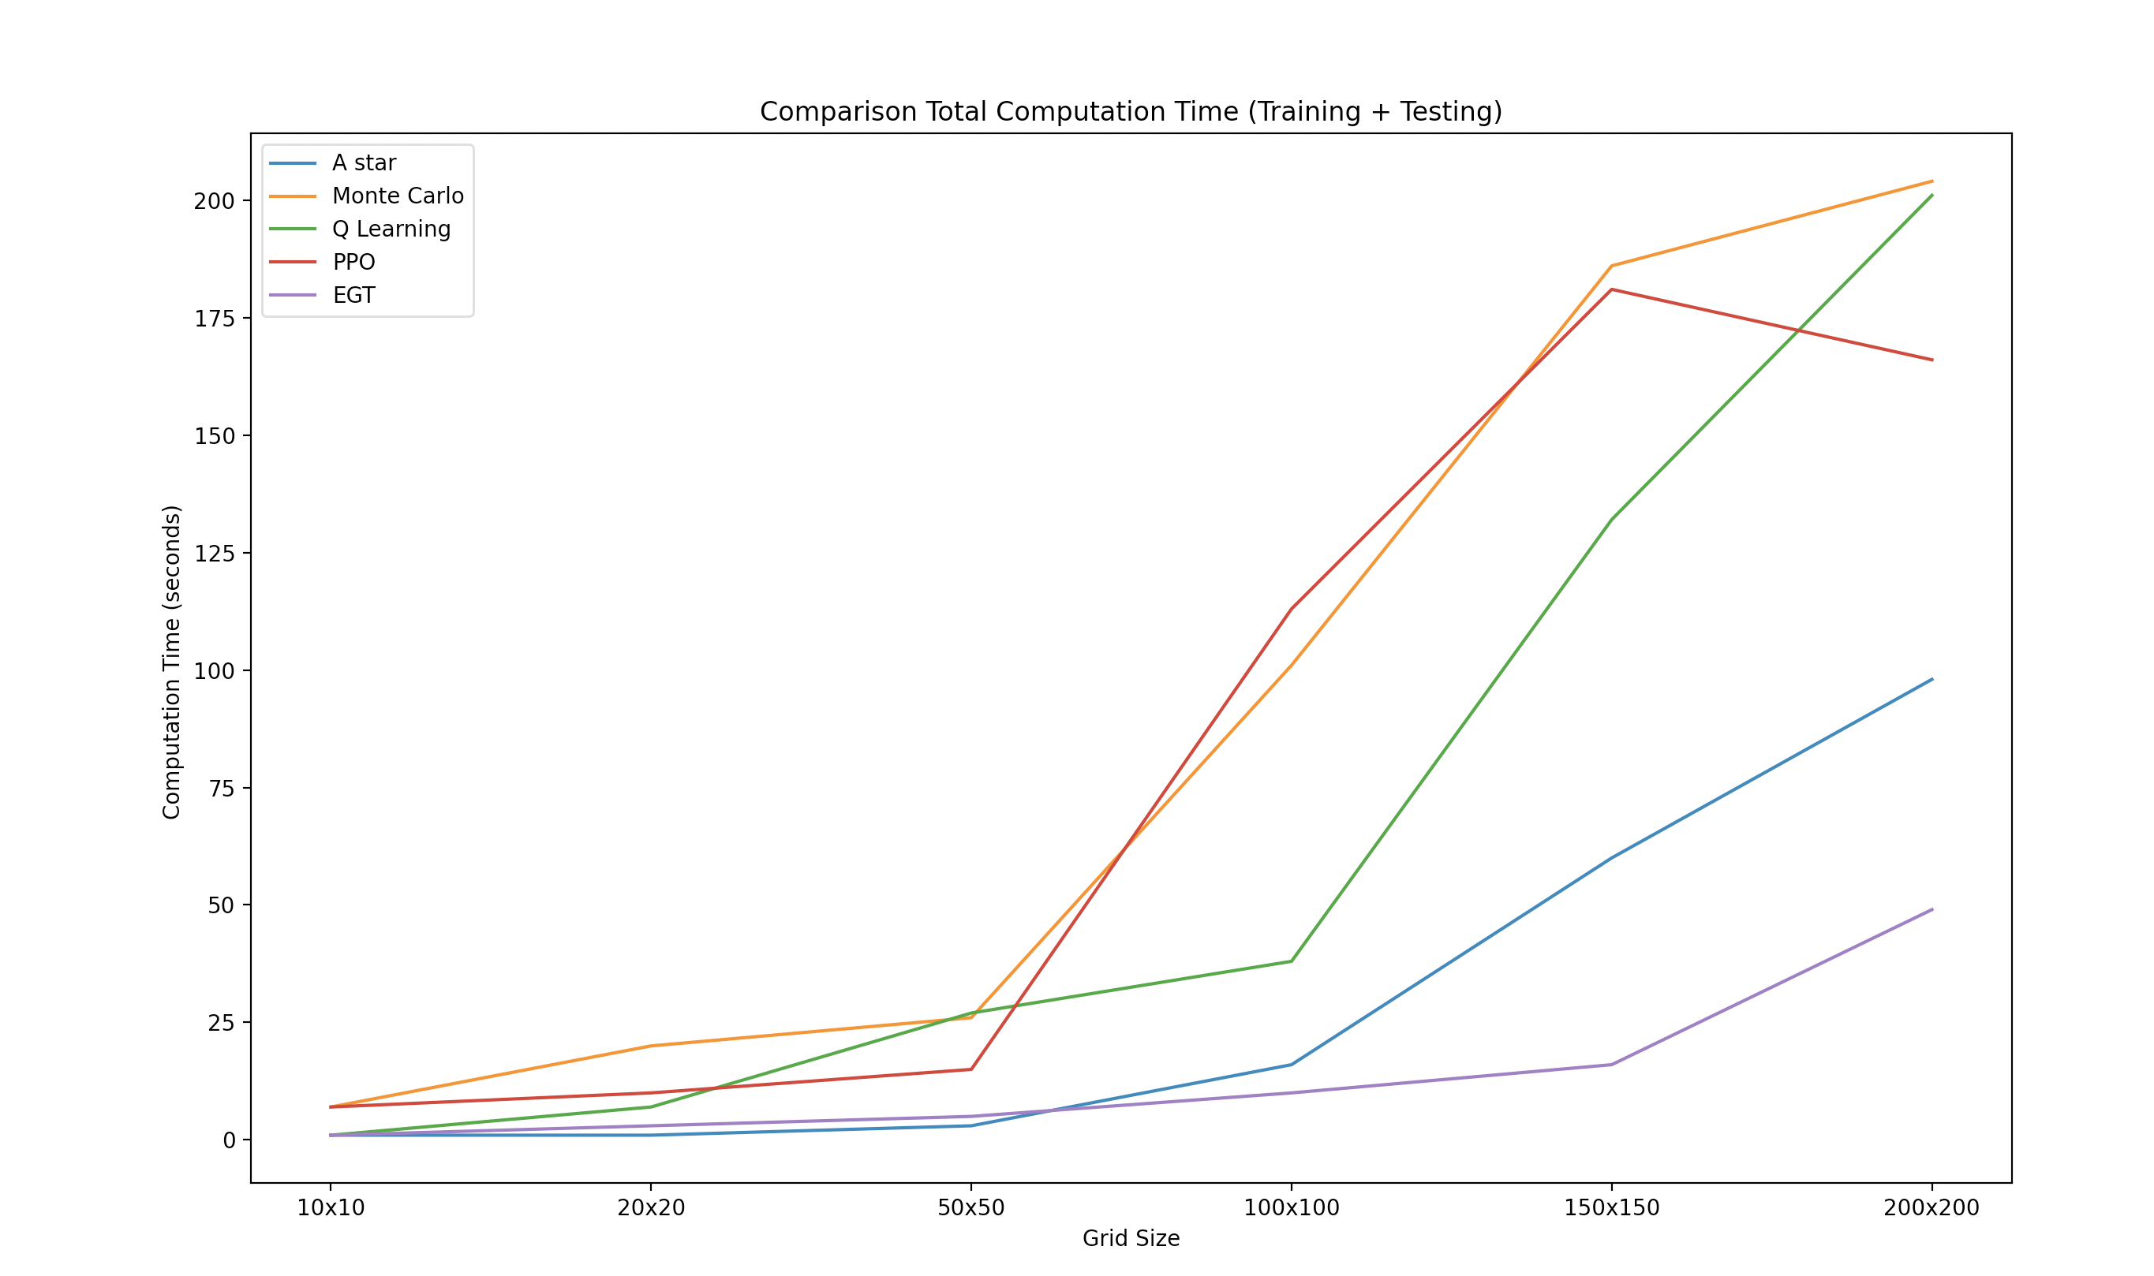
Results and Comparison to known algorithms

Slide 7
Next Steps and Future Work
To extend this problem to 3D spaces
To work with a dynamic environment, with moving obstacles and test the generalisability of the policy that the algorithm is learning
To work on a never-ending version of the problem: new agents keep popping up in locations
To use STL properties to compare and improve safety and robustness of the algorithm

